Slide 1


Tamper Proof Certificate Issue
&
ONLINE Verification System
Blockchain Technology Based Solution by
LearningChain
Sapphirus Systems
Sapphirus Systems

Slide 2



Who We Are?
Sapphirus Systems is a global Software company offering BlockChain based solutions.It is Headquartered at Hyderabad.
Sapphirus has been providing complete business solutions to various organizations. We have helped organizations from different industries such as education, banking & finance, telecom, and computing globalize their operations.
LearningChain comes from Sapphirus Systems Private Limited which offers institutions to Secure Students digital certificates for Lifetime.
Sapphirus Systems

Slide 3
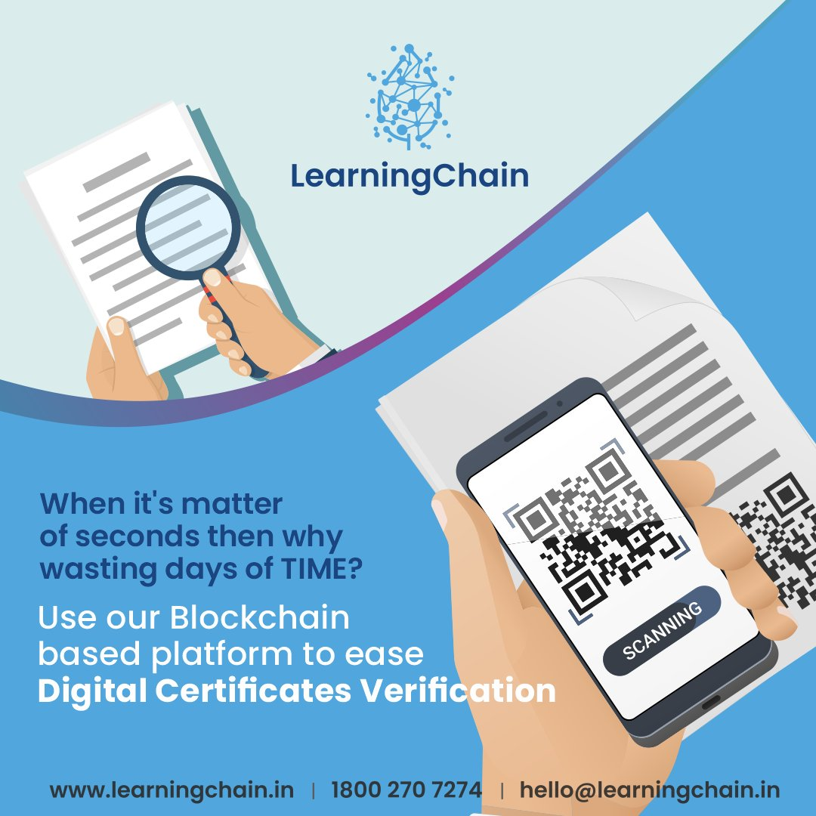
LearningChain
Educational institutions can rely on LearningChain to issue BlockChain enabled certificates to students, system generated tamper proof QR codes are provided to students to share it with employers for instant verification.
Authenticity of certificate can be validated by scanning QR Code from verification agencies, employers anytime with 100% confidence. Encrypted, time stamped certificates will be on BlockChain network for lifelong.
Key Features:
      Immutable
      Instantly Verifiable
      100% Data secured
      Easily shareable
      Globally Acceptable
Sapphirus Systems

Slide 4
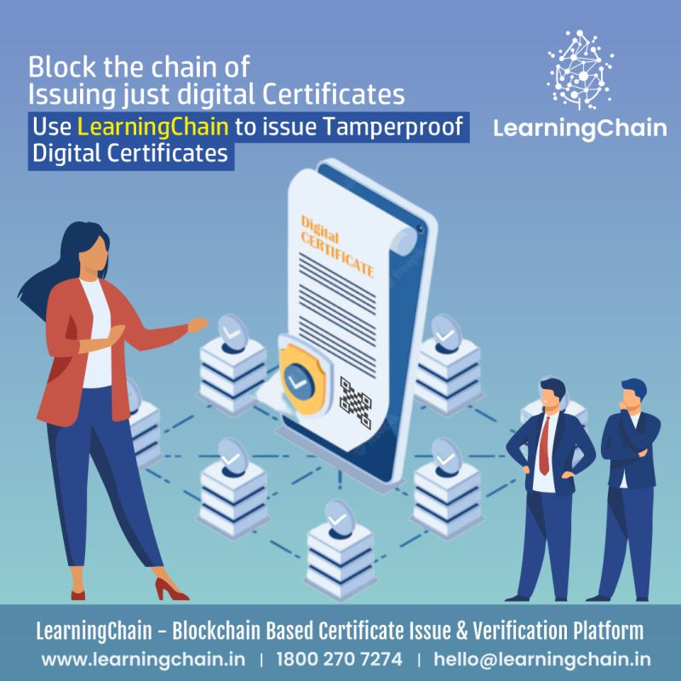
Why LearningChain?
LearningChain is a BlockChain powered Digital Certificate Issuance platform enables world to move from a traditional manual certification process to fully automated process for faster generation of digital certificates.
Key Advantage of tamper-proof digital certificates enables world to minimize the fraudulent certifications. Also single-click verification of digital certificates puts stop to time consuming traditional manual verification enabling cost savings to verifiers and institutions.
No one can delete or tamper with BlockChain data once issued, and unlike other companies the individuals have access to their portfolio forever.
Sapphirus Systems

Slide 5
Advantages of LearningChain
University / Institute | Employers | Students
Institutes can generate revenue by using LearningChain | Instantly Verifiable | Students sharing BlockChain certificates on social media indirectly makes brand more visible
Universities can secure the student digital certificates for life time with tamper proof | Less Man-Power | Globally Acceptable
Decentrailization of data on BlockChain makes it highly secured | Saving Time / Energy / Travel / Expenditure | Student can secure all certificates at one place in Mobile Application
Easily sharable certificates on social media makes brand more visible | 100% Accuracy | Access to certificates for Lifetime
Sapphirus Systems

Slide 6

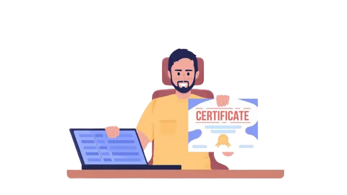
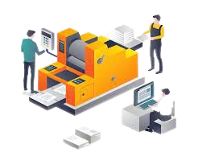
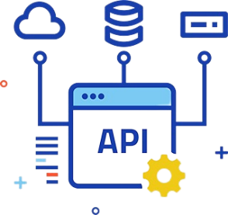
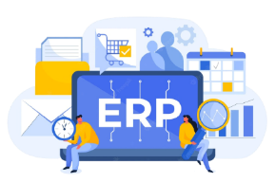

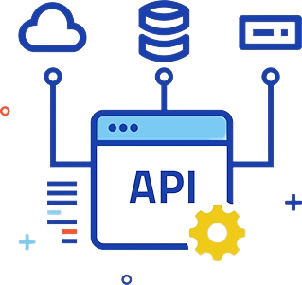


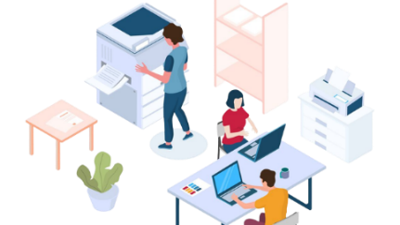


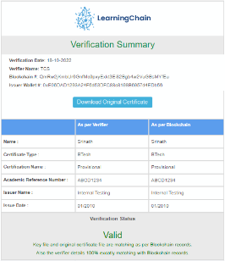


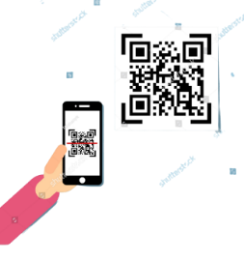
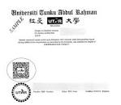

LearningChain Ecosystem
Institution
Result Declaration Student Certificate Print Data
LC API Integration Process for Blockchain secure QR code generation
Certificate With Secure QR Code Printing Process
Dedicated Printer
Certificate with Secure QR Code
LC API Integration Process for Blockchain Secure QR Code Generation
Certificate With Secure QR Code Printing Process
In House Preprinted Stationary
DigiLocker
Institution
Student Receives Certificate with secure QR code
Student Blockchain Details
QR Scanning
Verifier
Apply for Job/Admission

Slide 7
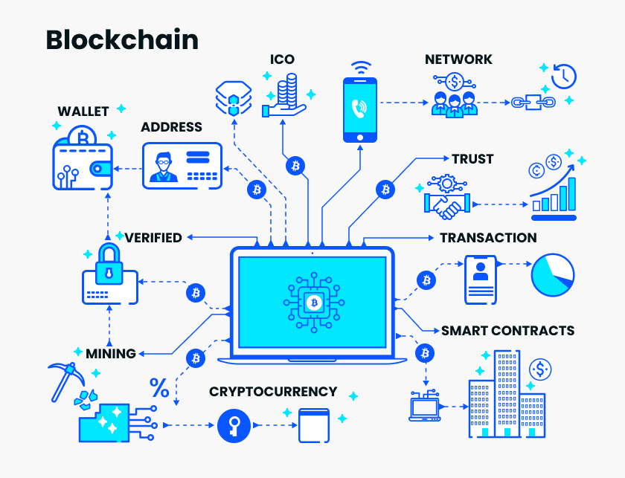
BlockChain
BlockChain is a system of recording information in a way that makes it difficult or impossible to change, hack, or cheat the system.
A BlockChain is essentially a digital ledger of transactions that is duplicated and distributed across the entire network of computer systems on the BlockChain.
Technology that allows data to be stored and exchanged on a peer-to-peer basis.
A BlockChain Consists of blocks that holds batches of valid transactions. Each block typically contains a hash pointer as a link to a previous block, a timestamp and transaction data.
Sapphirus Systems

Slide 8
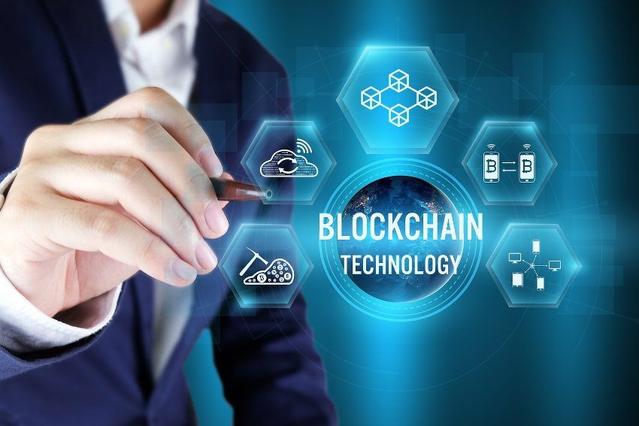
Benefits Of BlockChain Technology
Decentralized structure
Greater transparency
Instant traceability
Increased efficiency and speed
Immutability
Improved security and privacy
Sapphirus Systems

Slide 9
Case Studies of BlockChain Technology
BlockChain has the potential to be a disruptive technology across industries, with varying impacts on finance. While many applications are still at the exploration stage, there are plenty of examples demonstrating how the technology could be used.
(CBSE) has created an academic BlockChain document system.
IIT Kanpur PM Modi launches BlockChain-based digital degrees at IIT Kanpur.
Maharashtra minister launches project to issue caste certificates via BlockChain.
Deloitte India is working on a pilot on BlockChain based rewards and recognition program.
In 2017, Central New Mexico Community College became the first community college to issue student-owned digital diplomas using BlockChain.
Sapphirus Systems

Slide 10







Our Partners
Firstname
SLRTCE College
Sapphirus Systems
VCET College
Sapphirus Systems

Slide 11


Sapphirus Systems
Sapphirus Systems

